Slide 1


INDIAN INSTITUTE OF INFORMATION TECHNOLOGY, PUNE
TEAM TRAVEL BUDDY

Slide 2






Slide 3

THE PROBLEM

Slide 4
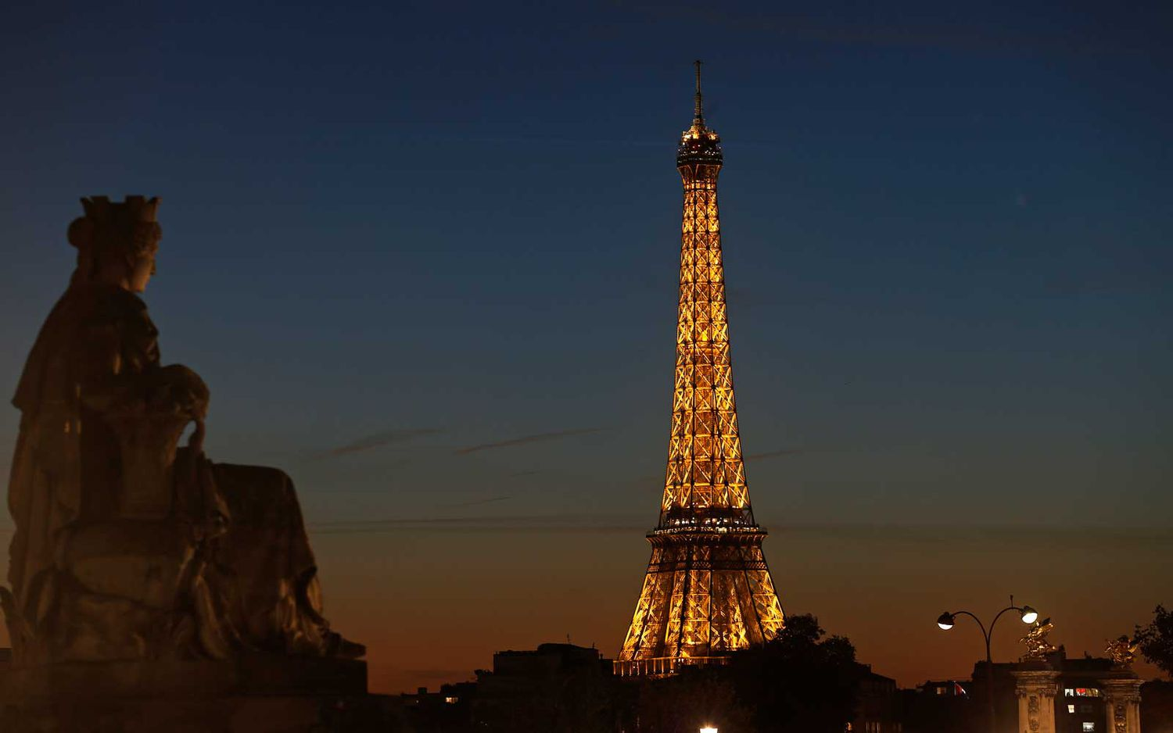

Slide 5
EIFFEL TOWER
Gustave Eiffel 1887
Foreign visitors every year:
5.5 Million
Most visited monument in the world.

Slide 6
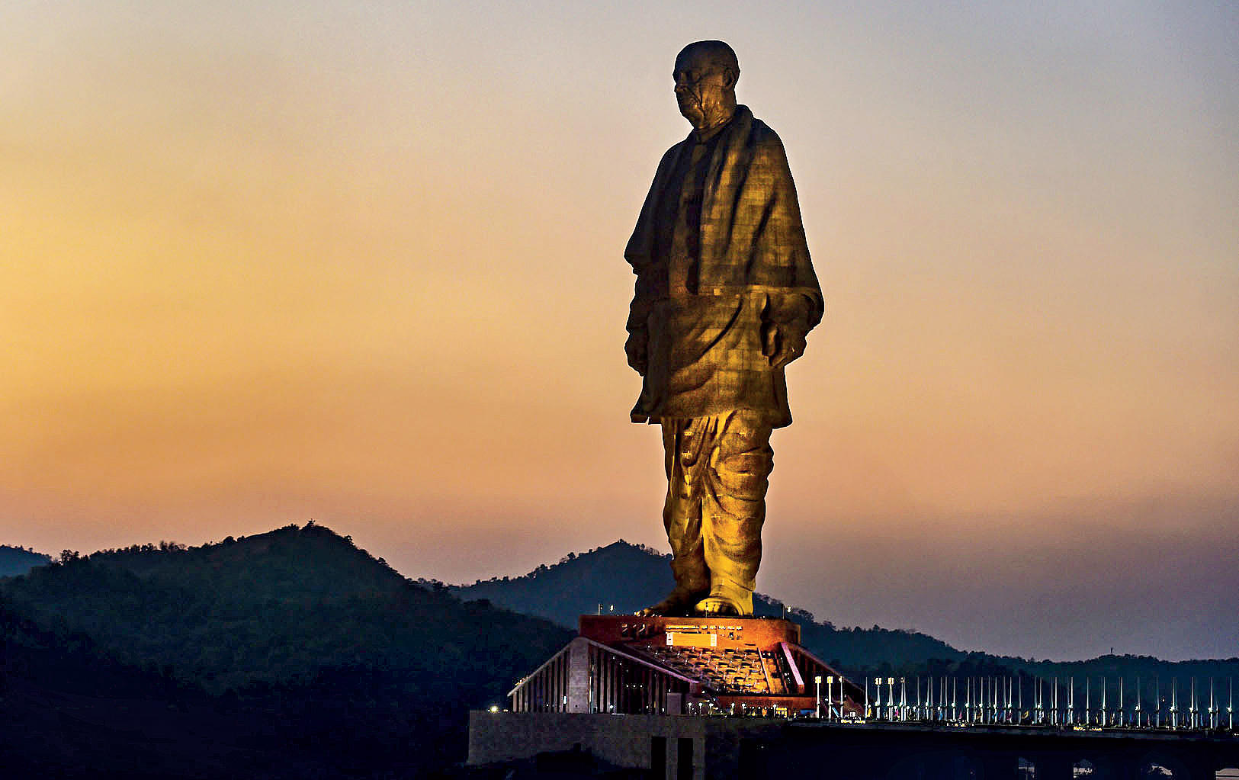

Slide 7
STATUE OF UNITY
Ram V. Sutar
2018
Foreign visitors every year:
500K
Tallest statue in the world.

Slide 8

WHAT IS THE ACTUAL PROBLEM WITH TOURISM IN INDIA?
IS IT THE STEREOTYPE ABOUT INDIA?
IS SAFETY THE ISSUE?

Slide 9
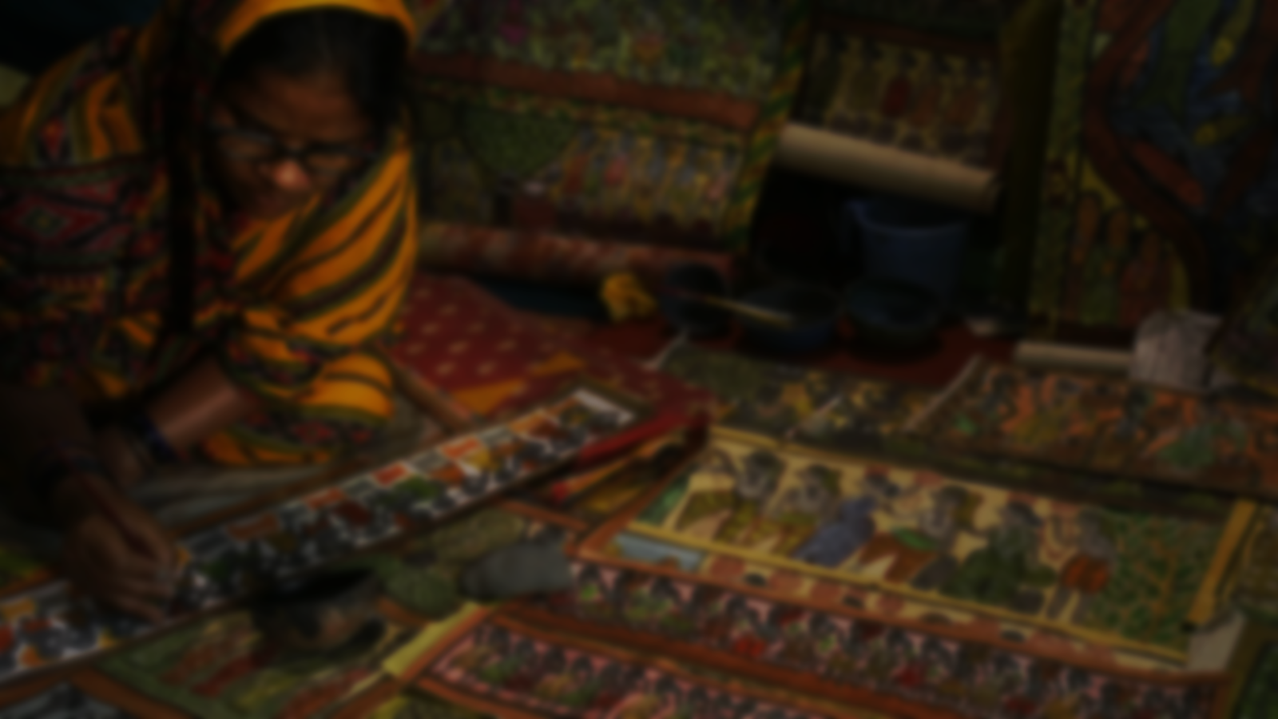

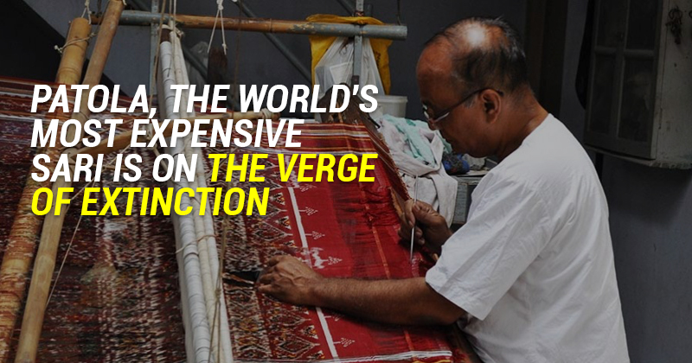
BUT...WHY?

Slide 10
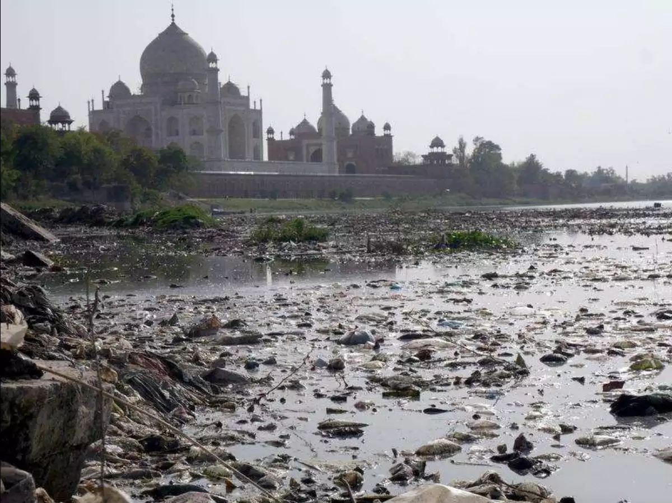

Slide 11

WHAT WE PROPOSE..

Slide 12
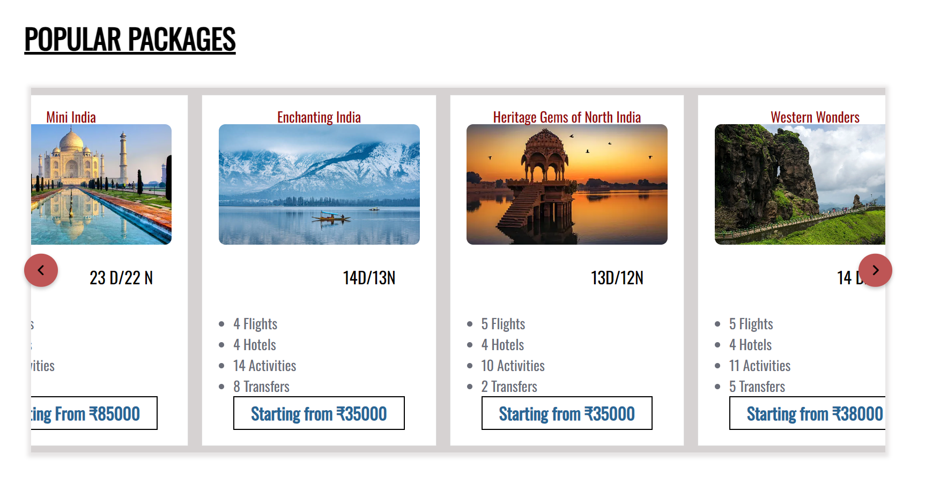

Slide 13

RESPONSIBLE TOURISM

Slide 14

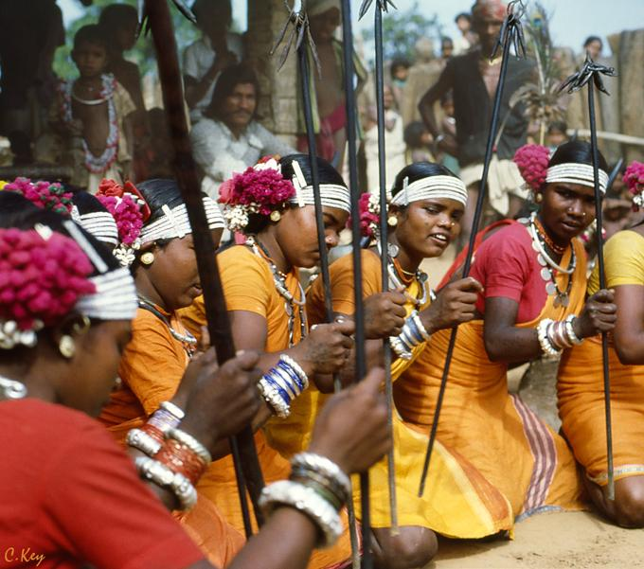
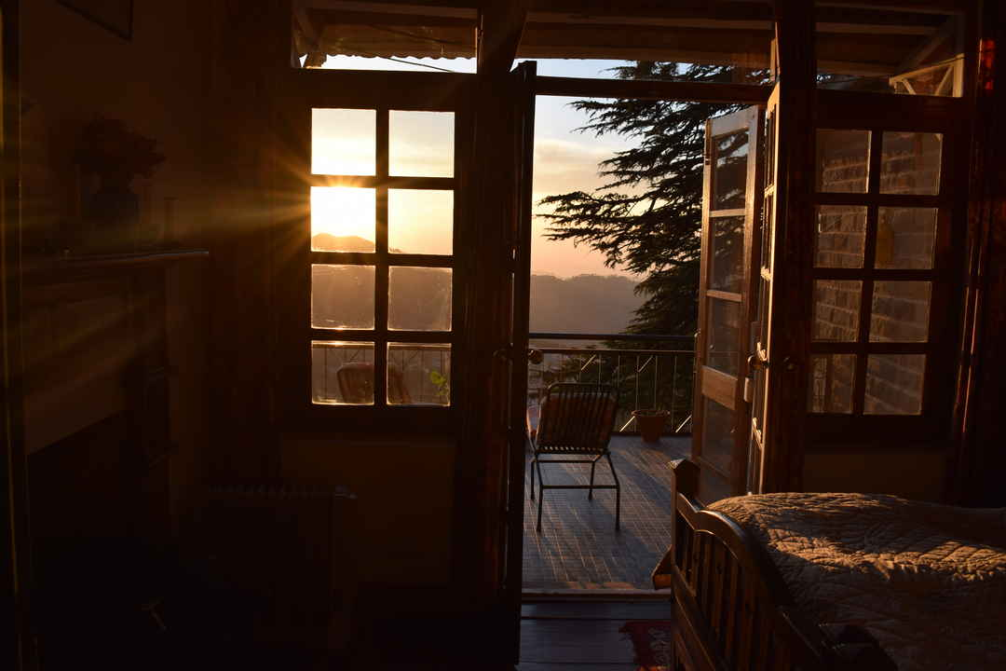



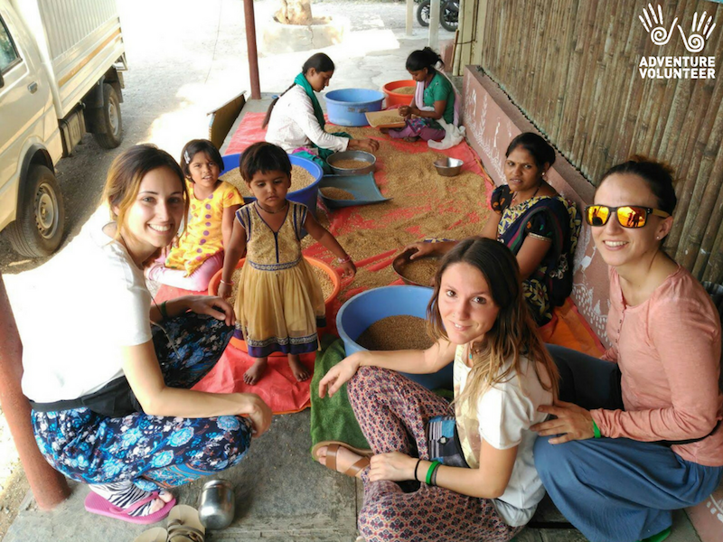
MEDICAL ASSISSTANCE

Slide 15

ASSURED HOMESTAYS

Slide 16

RESPECT LOCAL CULTURE

Slide 17

TRAVEL WITHOUT INCREASING CARBON FOOTPRINT

Slide 18

VOLUNTOURISM

Slide 19
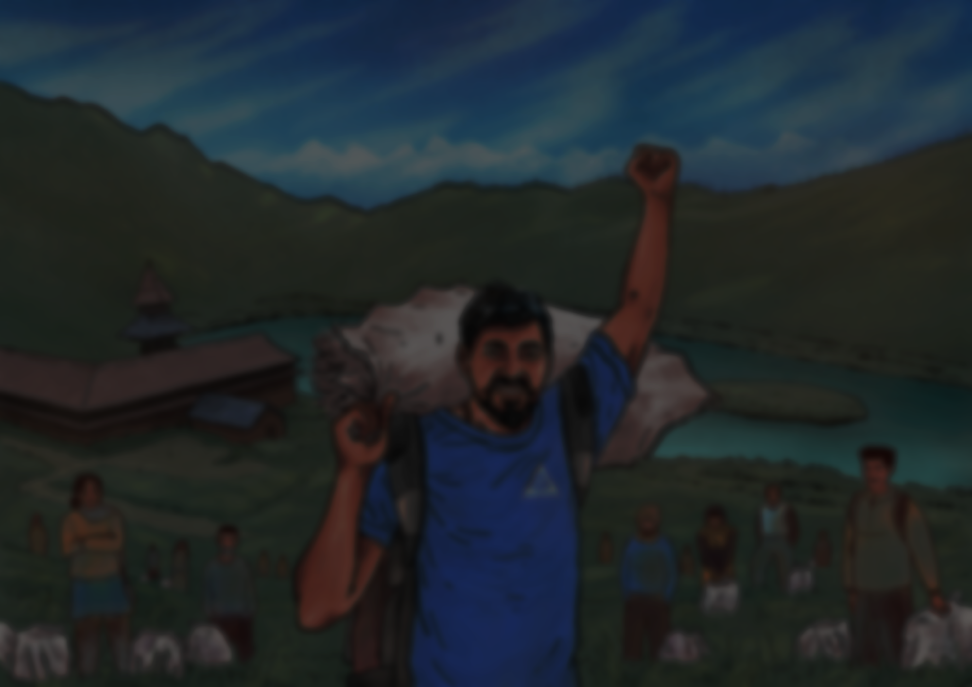
SAY NO TO SINGLE USE PLASTIC

Slide 20

PROMOTING LOCAL CULTURE

Slide 21


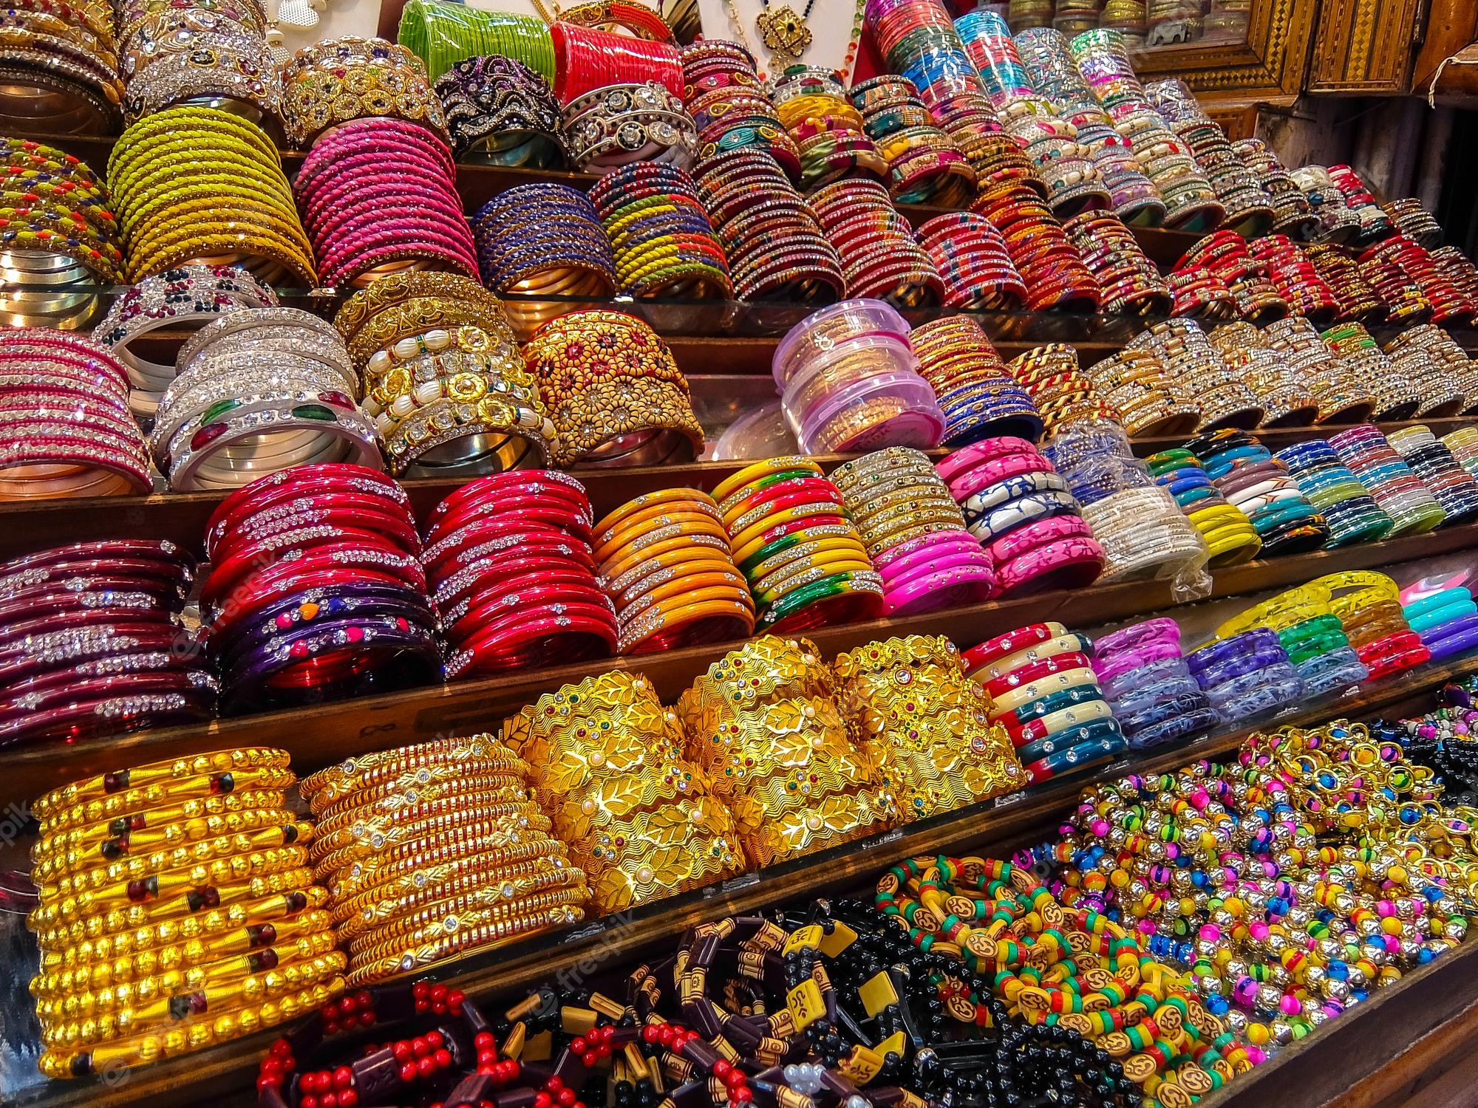
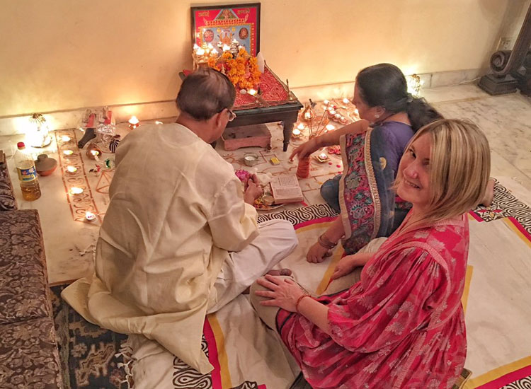
BUY THE LOCAL EXPERIENCE

Slide 22

ENJOY THE LOCAL FESTIVITES

Slide 23

INDULGE IN LOCAL LIFESTYLE

Slide 24

ECOFRIENDLY TOURISM

Slide 25

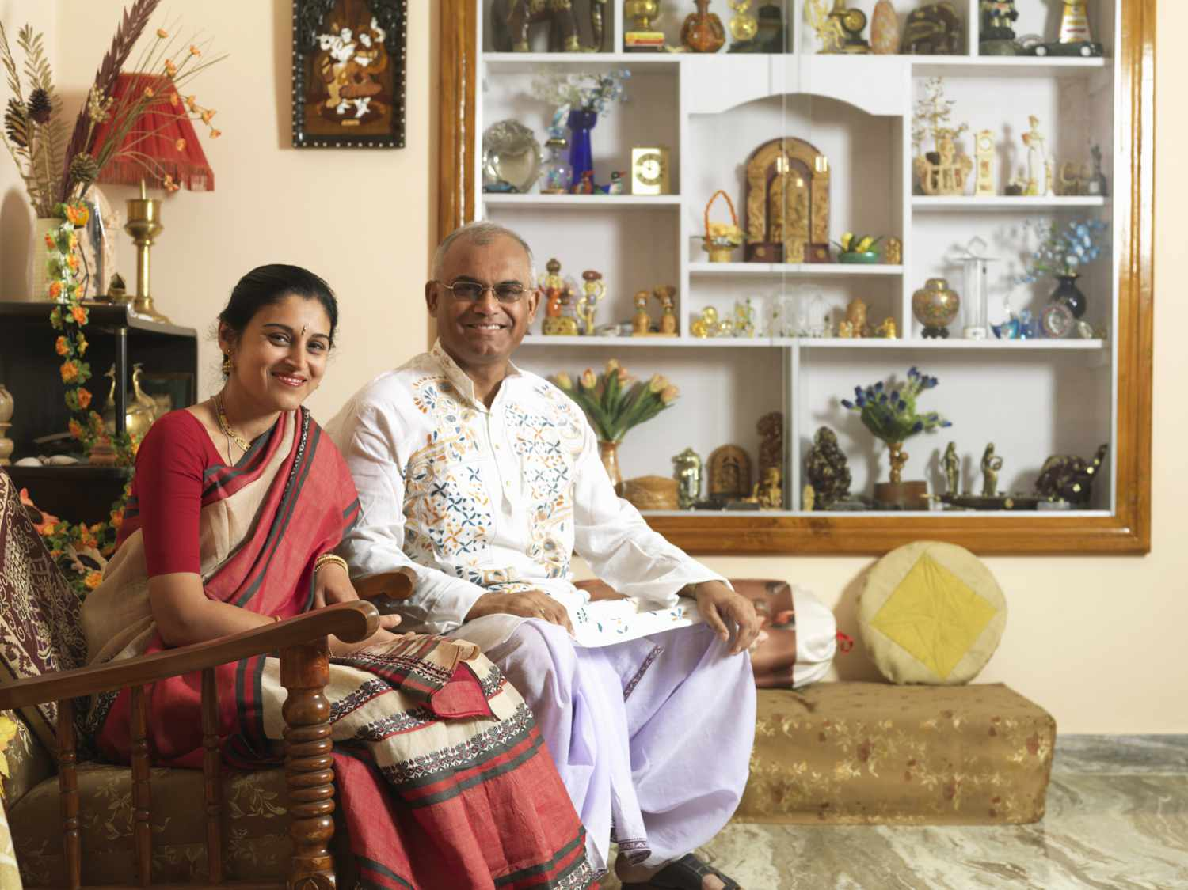

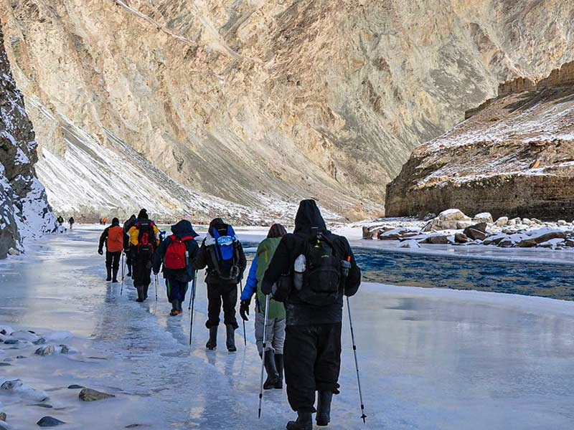

LOWEST CARBON ECONOMY

Slide 26

SPECIAL DISCOUNT ON HOMESTAYS

Slide 27

NATURE SPORTS

Slide 28

PROMOTING ECO AWARENESS THROUGH BLOGS AND SOCIAL MEDIA

Slide 29

THE TEAM

Slide 30

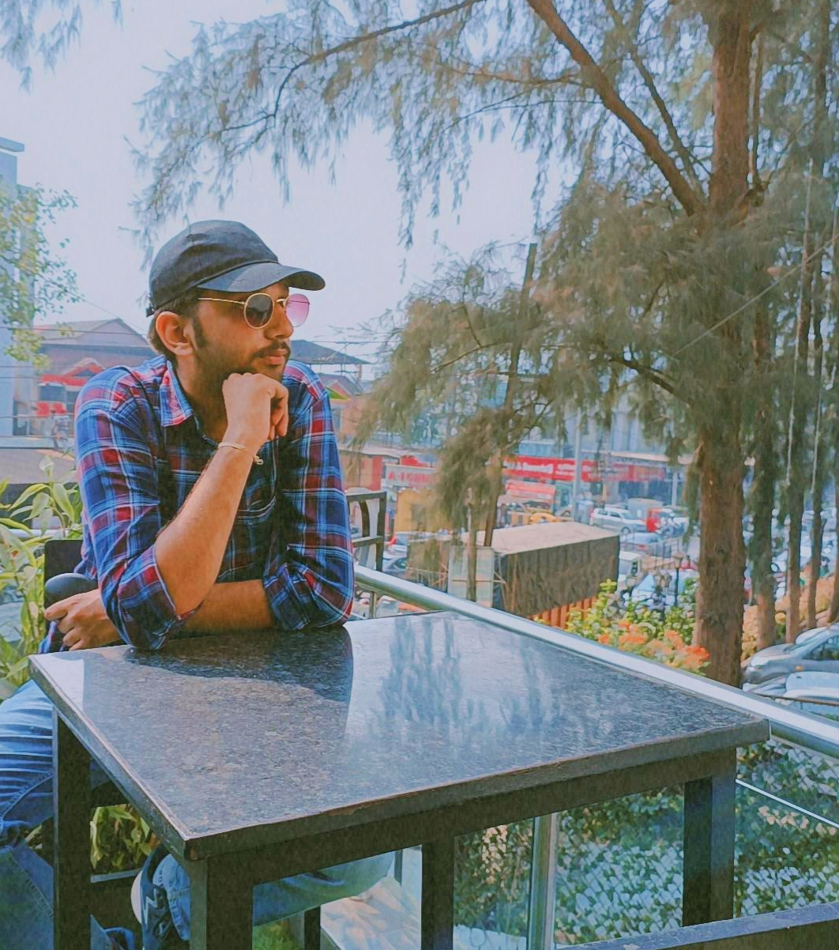
TEAM LEADER
DEV SHARMA
With wanting to contribute to the country, an entrepreneurial spirit and his love towards travelling, he decided to take the idea of Indian Tourism to another level in hopes to out India in the list of travel giants.

Slide 31
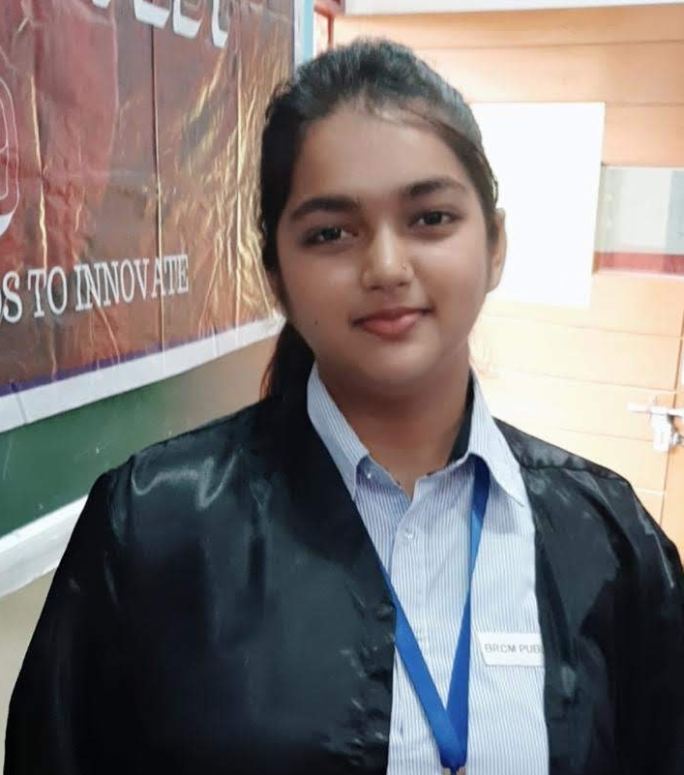
CREATIVE DIRECTOR
KOMAL DESODHIA
Leading our talented creative team, she guide ideas from inception to fruition, nurturing a culture of innovation. Her meticulous eye for detail and passion for innovation ensure that every design element is both impactful and purposeful.

Slide 32
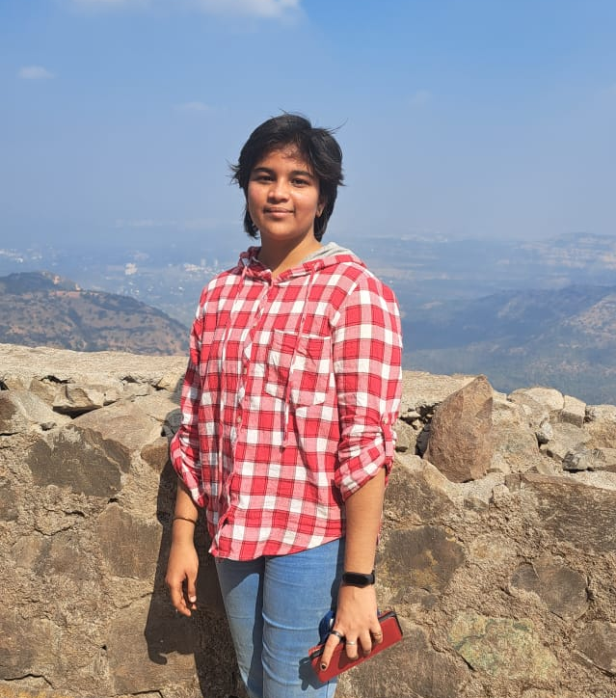
DATA RESEARCHER
RAMONA NANDAVARAM
A determined soul who can complete any task with full dedication and creativity. She’s the navigator who guide us through the sea of data, helping us chart a course to success. Her attention to detail ensures accuracy and reliability in every piece of information she presents.

Slide 33

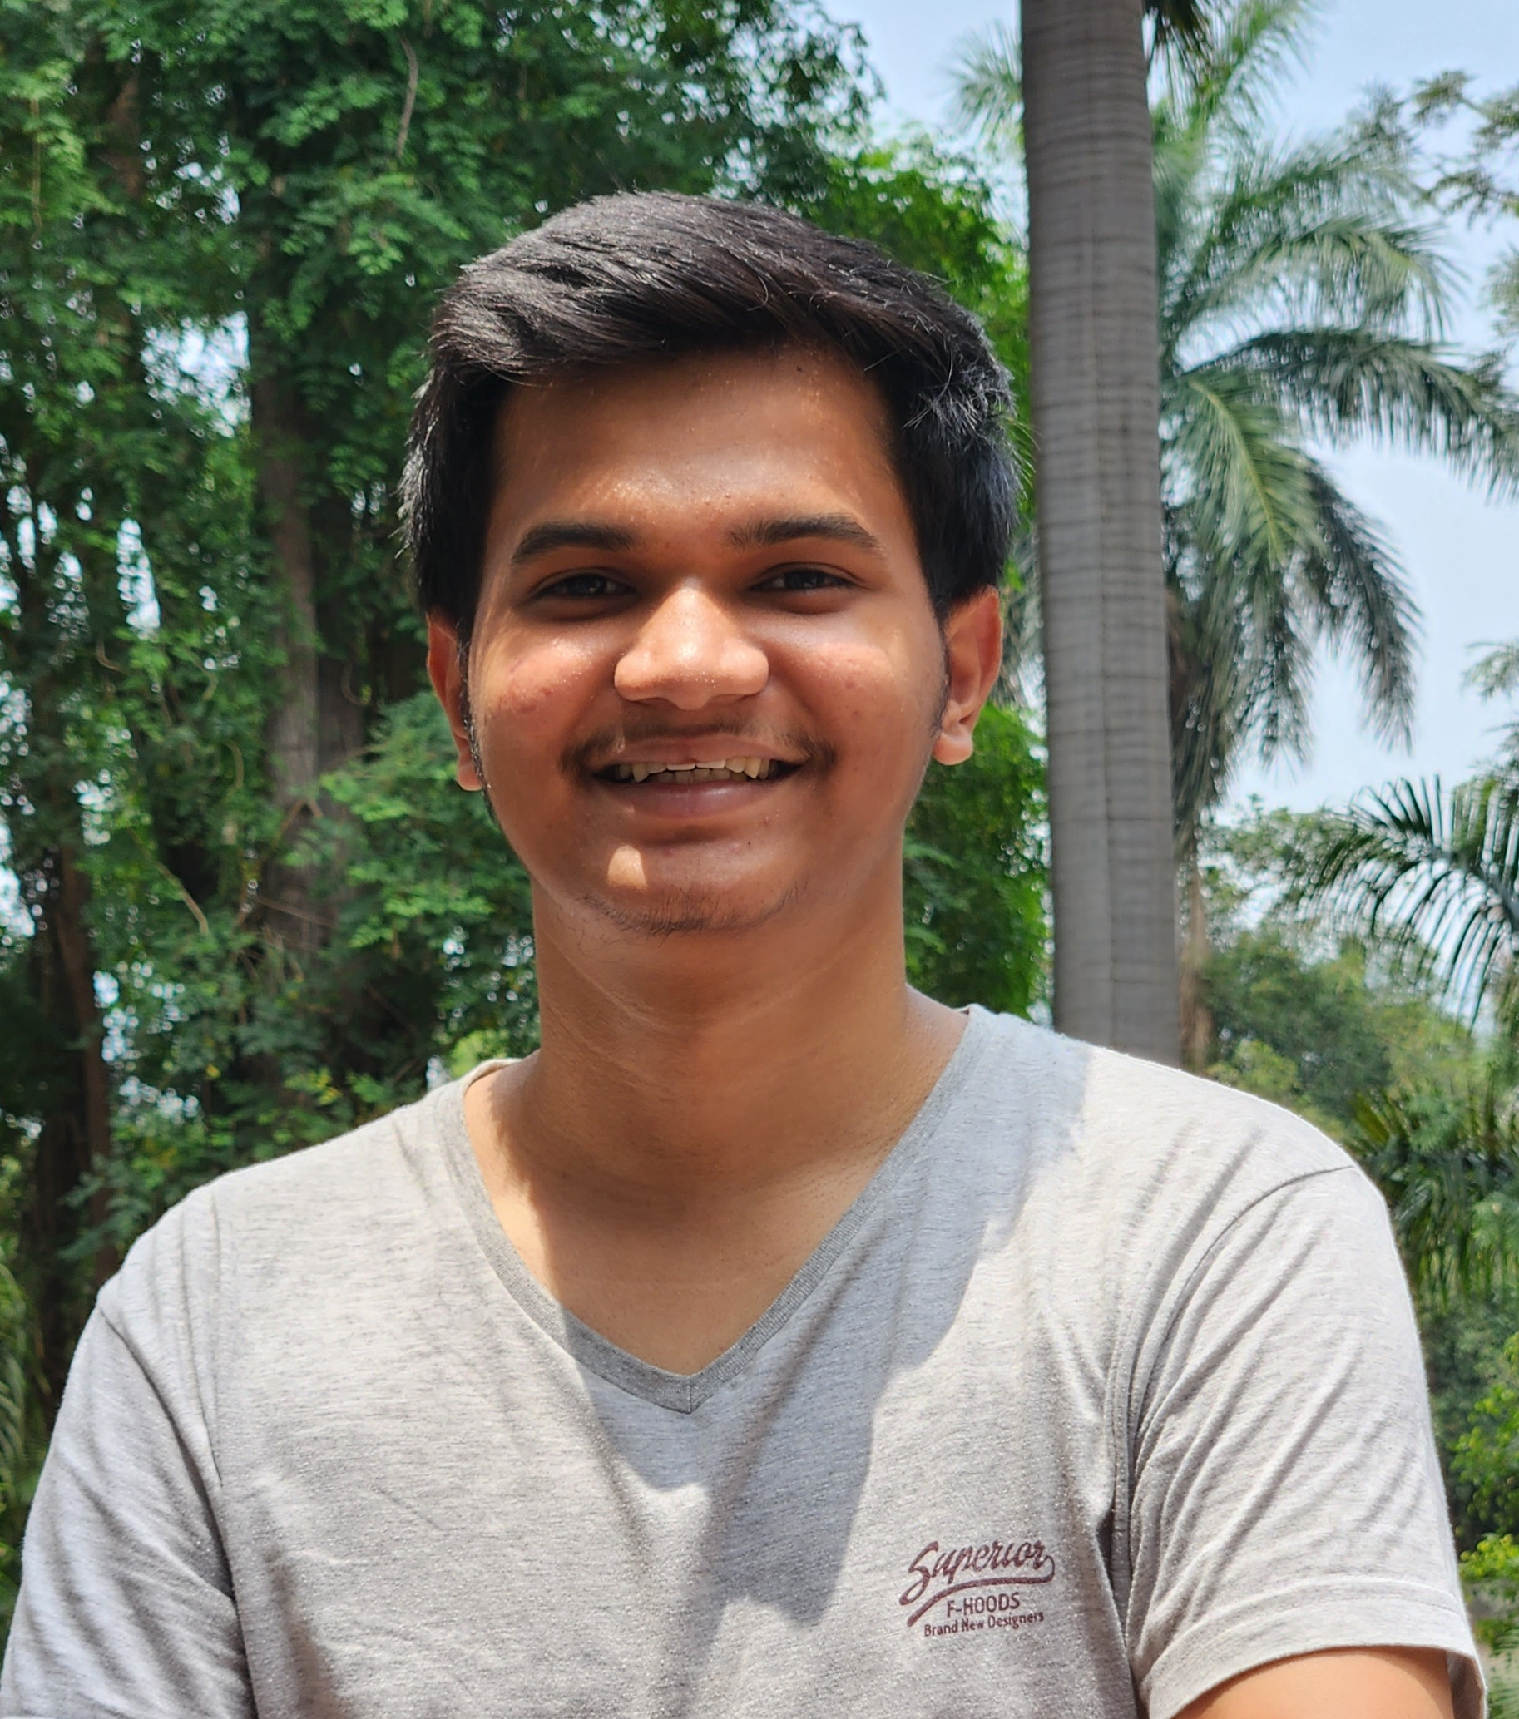
DATA RESEARCHER
ARJUN SAGAR
With a keen eye for detail and a knack for digging deep, he sift through mountains of information to find the hidden gems. Armed with advanced tools, he transform raw information into actionable knowledge, guiding our decisions.

Slide 34
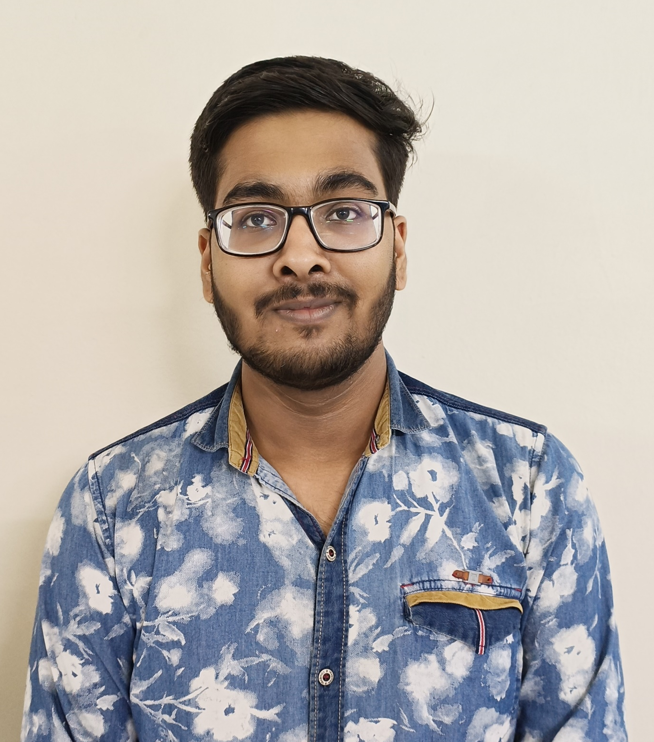
FRONT-END DEVELOPER
NAMAN GOYAL
He love solving problems and always keep up with the newest tech trends. His skill set spans a spectrum of languages, enabling him to sculpt software that merges functionality with aesthetics seamlessly. If something goes wrong, they're like superheroes who come to the rescue.

Slide 35
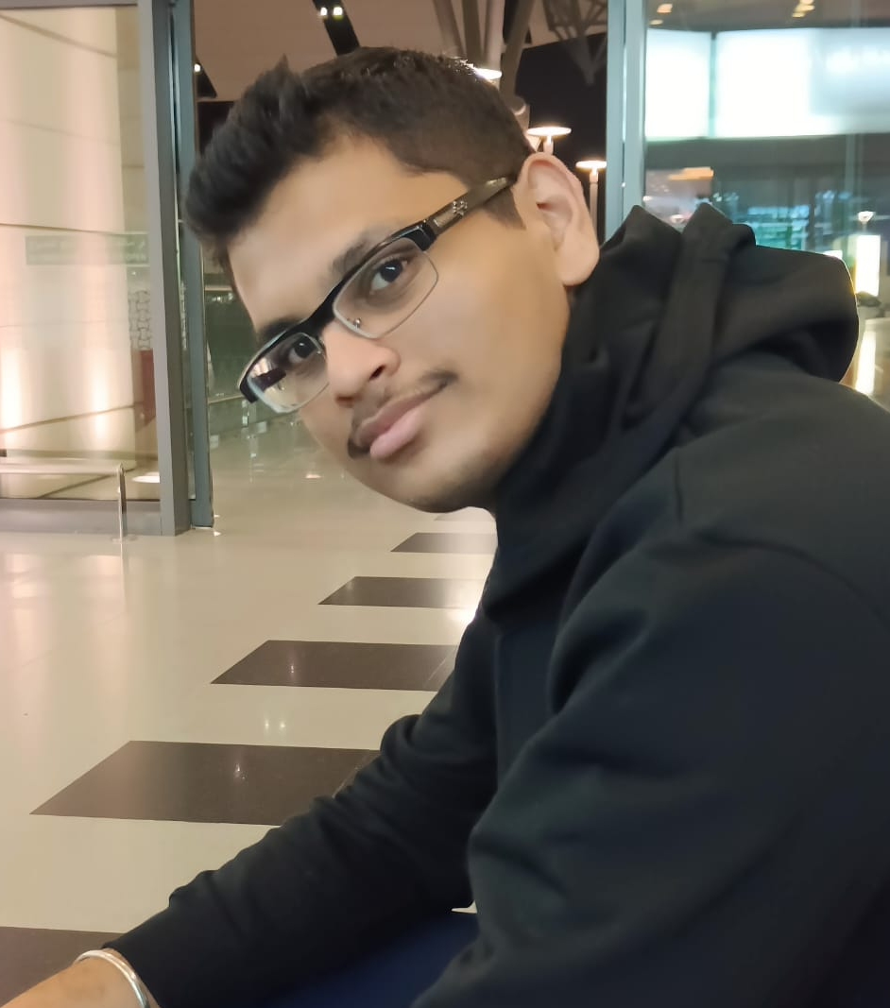
BACK-END DEVELOPER
DEEPESH PATIL
A hardworking individual with an enthusiasm for coding and drone technology. With a profound passion for problem-solving, he meticulously craft lines of code that power innovation. Though he is an NRI, he has a vision to put India forth on global stage.

Slide 36

TECHNICAL APPROACH

Slide 37

OUR AIM IS TO BRING INDIA IN THE TOP 5 MOST TRAVELLED COUNTRIES AND PROVIDE A SAFE, TRUSTWORTHY, ENRICHING AND SUSTAINABLE TOUR EXPERIENCE.

Slide 38

THANK YOU

